Slide 1

Algorithms and Data Structures 2 CS 1501
Fall 2021
Sherif Khattab
ksm73@pitt.edu
(Slides are adapted from Dr. Ramirez’s and Dr. Farnan’s CS1501 slides.)

Slide 2
Announcements
Upcoming deadlines:
Homework 5 due on 2/21
Lab 5 due on 2/25
Homework 6 due on 2/28
Assignment 1 due on 3/14
Midterm exam on Wednesday 3/2
In-person, paper, closed book exam
Faculty Candidate Talk tomorrow at 10:00 am at Sennott Square 5317
Topic: self-balancing binary search trees
very relevant talk to this class!

Slide 3
Previous lecture …
Prefix-free Compression problem
Huffman coding as an optimal solution
Implementation details
storing the trie in the compressed file
Writing out variable-length bit strings

Slide 4
CourseMIRROR Reflections (interesting)
I found it interesting how Huffman trees are created
How to make a huffman tree
I enjoyed going through examples
It was quite fascinating how we were able to get back the original string after compression
Manually compressing/decompressing data using Huffman trees
How to reduce bits
The most interesting part of class was amount of bits you save with huffman’s algorithm.
Stepping through the Huffman compression algorithm and seeing the difference in bits once compressed

Slide 5
CourseMIRROR Reflections (confusing)
Huffman compression algorithm steps
Tree serialization/storage/encoding
The difference between the compression algorithm and what’s written to the file
why to use an RST to implement a Huffman tree
Why do we need to use a buffer to process bits?
The most confusing part about class was the pairing of nodes in the new tree.
The way to construct the forest in Huffmans compression can be a bit tricky as there are multiple ways to construct it

Slide 6
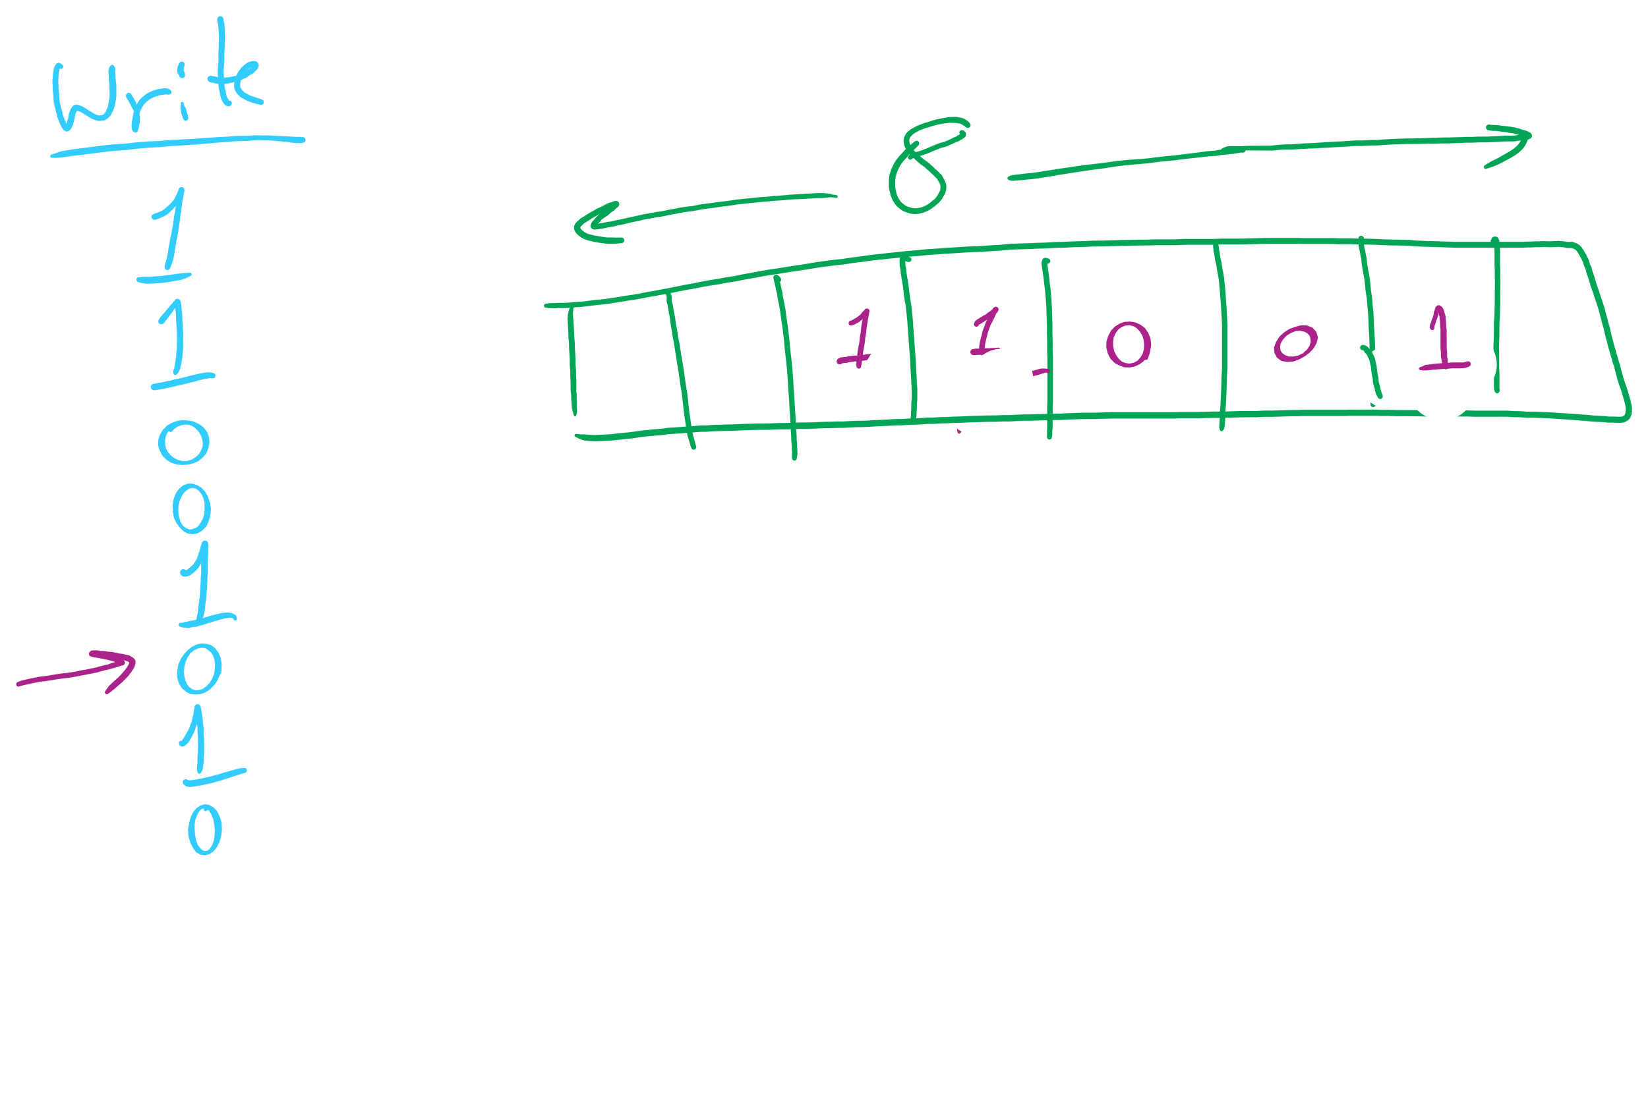
Binary I/O

Slide 7
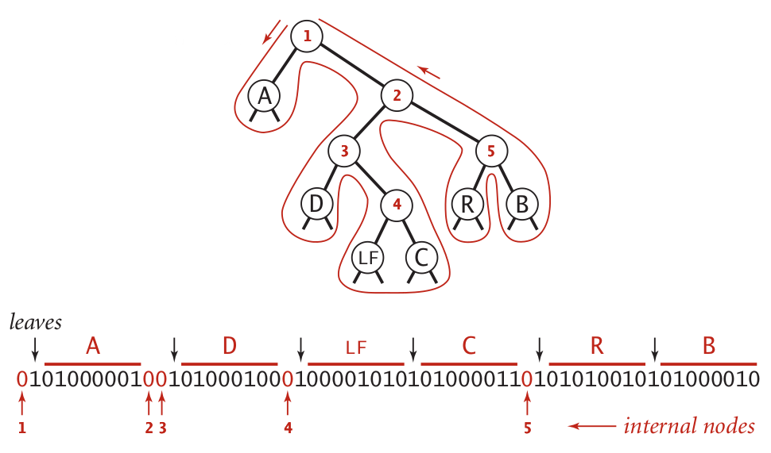
Representing tries as bitstrings

Slide 8
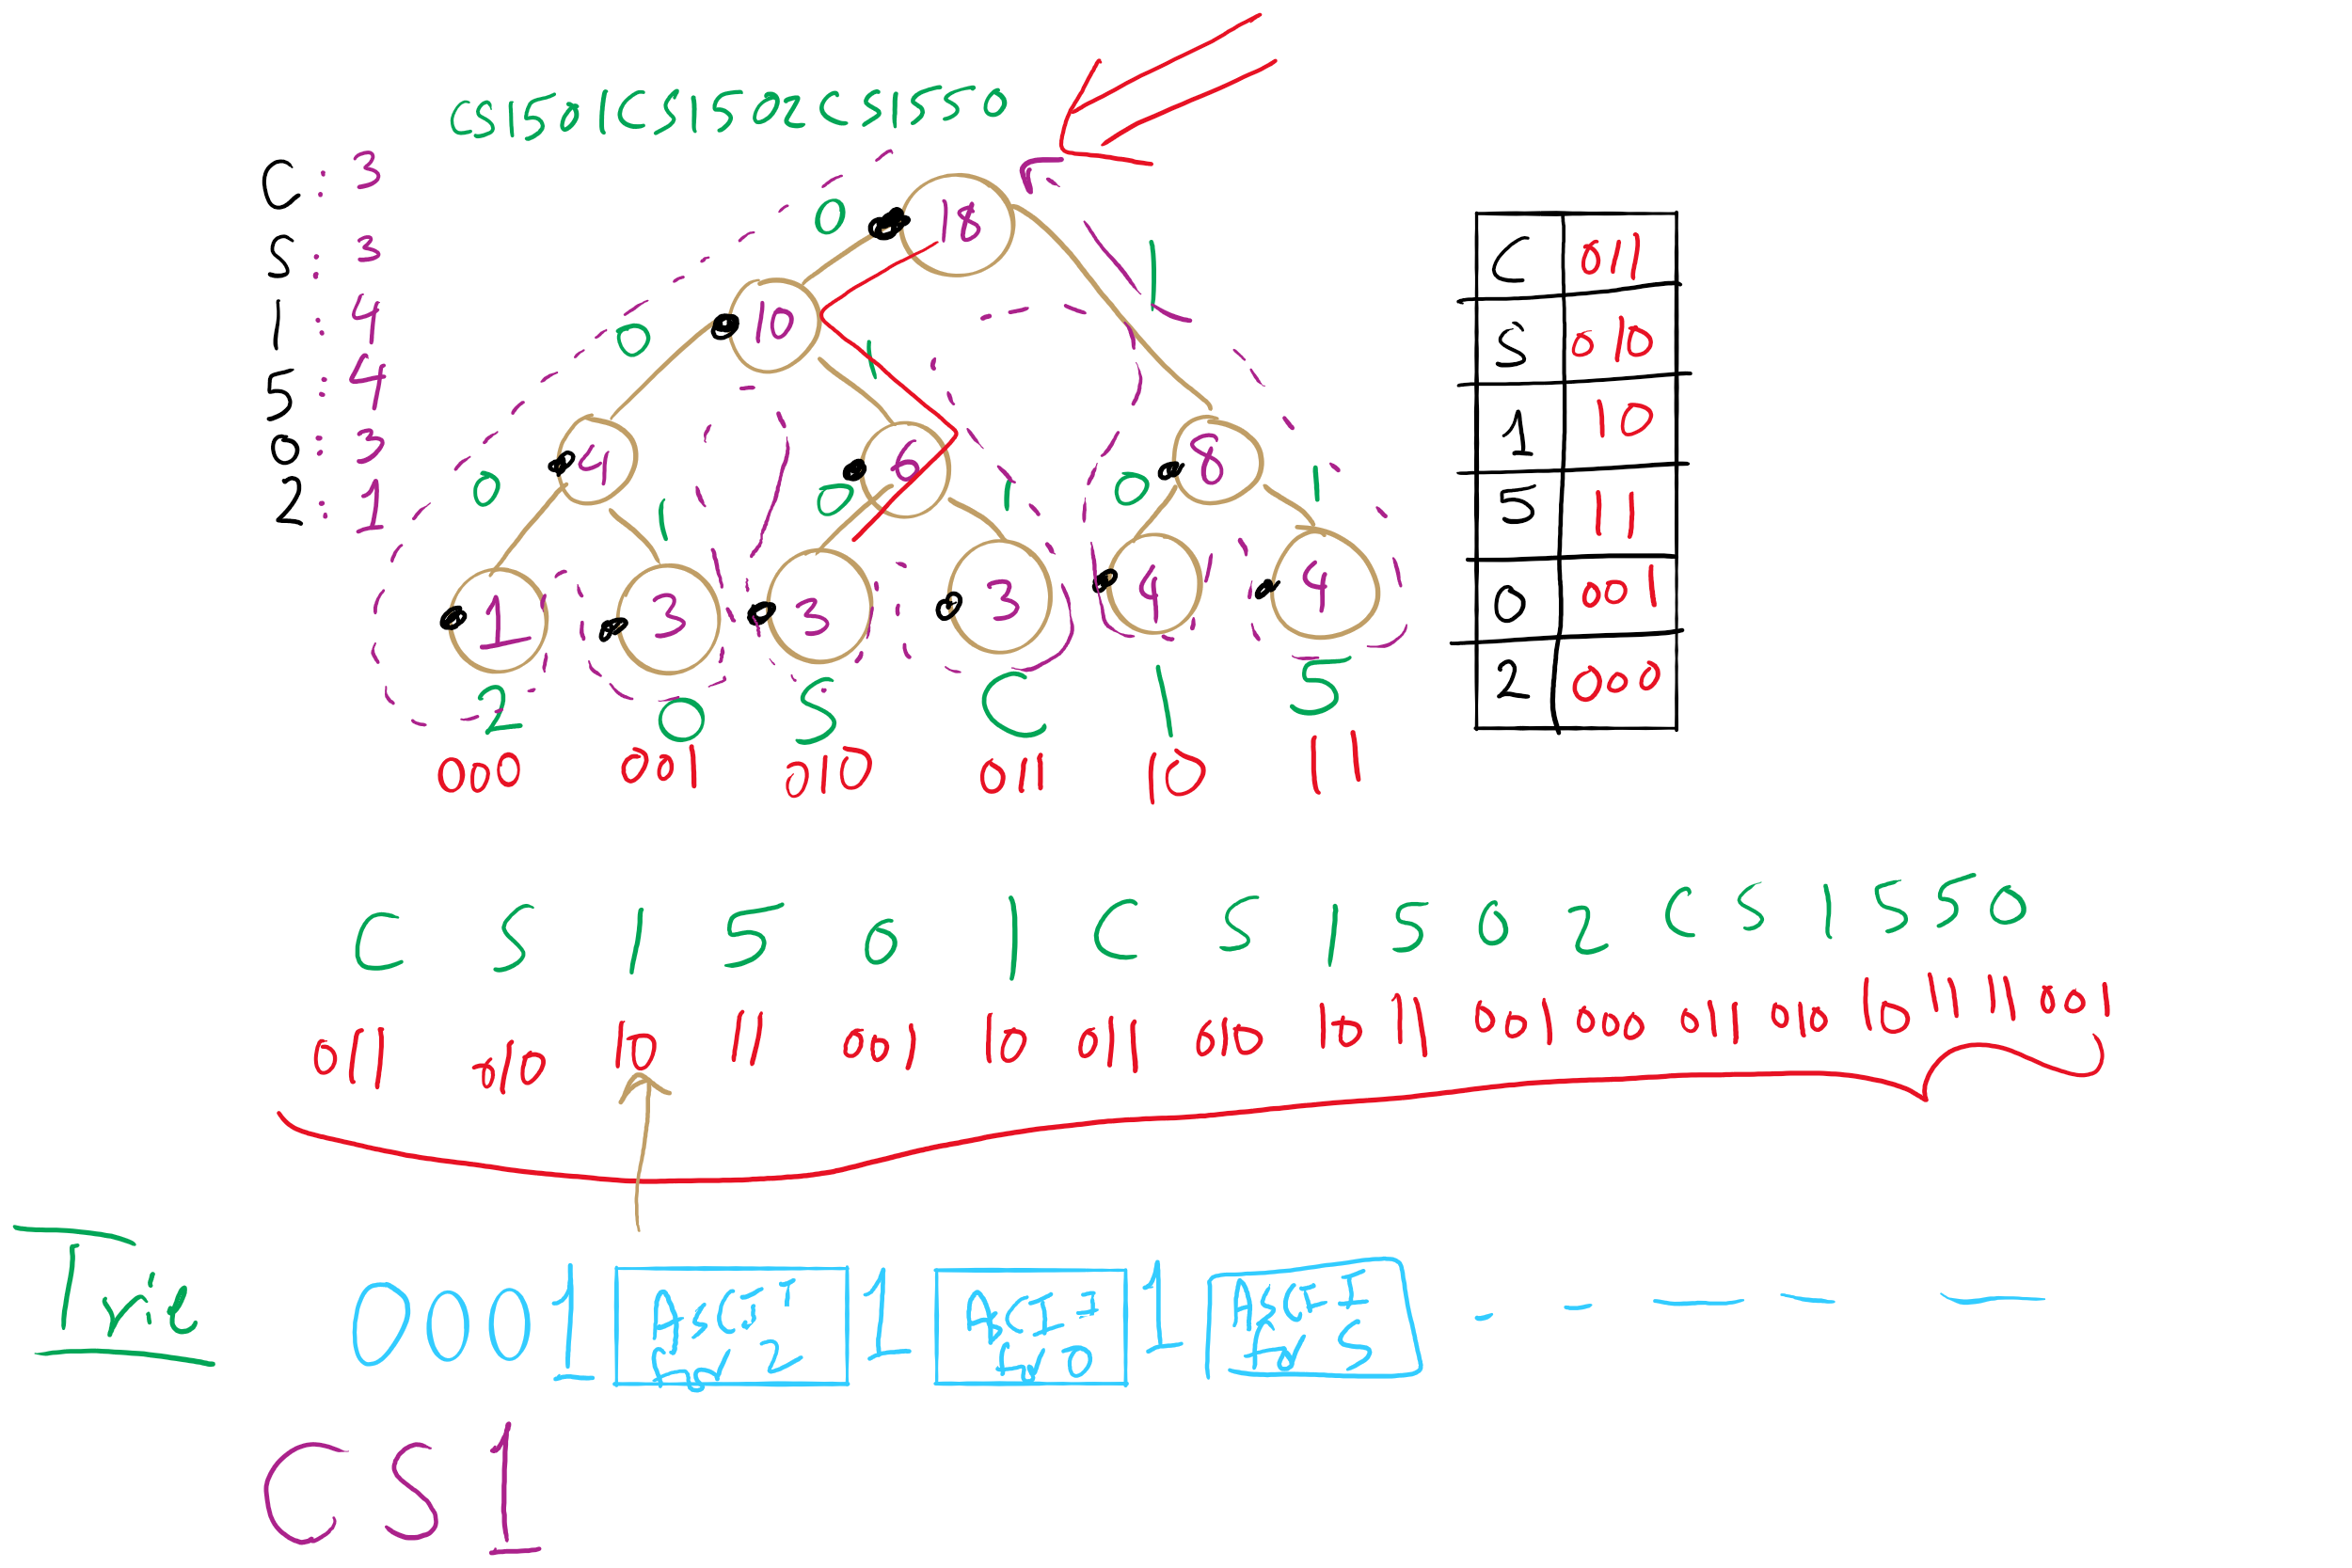
Huffman Compression Example

Slide 9
Huffman pseudocode
Encoding approach:
Read input
Compute frequencies
Build trie/codeword table
Write out trie as a bitstring to compressed file
Write out character count of input
Use table to write out the codeword for each input character
Decoding approach:
Read trie
Read character count
Use trie to decode bitstring of compressed file

Slide 10
How do we determine character frequencies?
Option 1: Preprocess the file to be compressed
Upside: Ensure that Huffman’s algorithm will produce the best output for the given file
Downsides:
Requires two passes over the input, one to analyze frequencies/build the trie/build the code lookup table, and another to compress the file
Trie must be stored with the compressed file, reducing the quality of the compression
This especially hurts small files
Generally, large files are more amenable to Huffman compression
Just because a file is large, however, does not mean that it will compress well!

Slide 11
How do we determine character frequencies?
Option 2: Use a static trie
Analyze multiple sample files, build a single tree that will be used for all compressions/expansions
Saves on trie storage overhead…
But in general not a very good approach
Different character frequency characteristics of different files means that a code set/trie that works well for one file could work very poorly for another
Could even cause an increase in file size after “compression”!

Slide 12
How do we determine character frequencies?
Option 3: Adaptive Huffman coding
Single pass over the data to construct the codes and compress a file with no background knowledge of the source distribution
Not going to really focus on adaptive Huffman in the class, just pointing out that it exists...

Slide 13
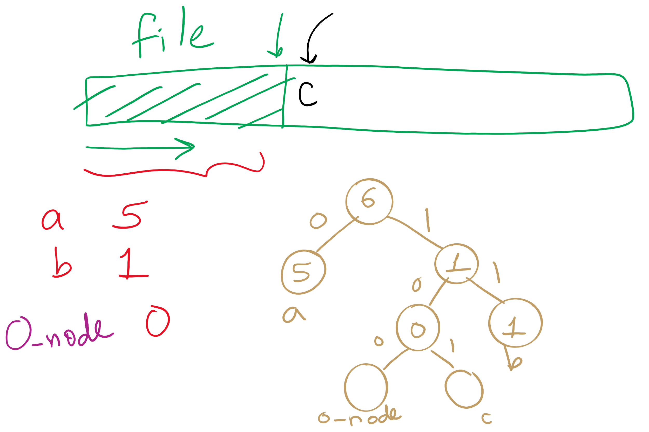
Adaptive Huffman

Slide 14
Further implementation concerns
Need to efficiently be able to select lowest weight trees to merge when constructing the trie
Can accomplish this using a priority queue
Need to be able to read/write bitstrings!
Unless we pick multiples of 8 bits for our codewords, we will need to read/write fractions of bytes for our codewords
We’re not actually going to do I/O on fraction of bytes
We’ll maintain a buffer of bytes and perform bit processing on this buffer
See BinaryStdIn.java and BinaryStdOut.java
Notes:
priority queues will be the subject of a lecture yet to come...

Slide 15
Ok, so how good is Huffman compression
ASCII requires 8m bits to store m characters
For a file containing c different characters
Given Huffman codes {h₀, h₁, h₂, …, h_{(c-1)}}
And frequencies {f₀, f₁, f₂, …, f_{(c-1)}}
Sum from 0 to c-1: |h_{i}|* f_{i}
Total storage depends on the differences in frequencies
The bigger the differences, the better the potential for compression
Huffman is optimal for character-by-character prefix-free encodings
Proof in Propositions T and U of Section 5.5 of the text

Slide 16
Problem of the Day
Huffman’s is optimal for character-by-character prefix-free encodings
Proof in Propositions T and U of Section 5.5 of the text
But can we do better than Huffman’s for lossless compression?

Slide 17
Problem of the Day: Lossless Compression
Input: A sequence of characters
n characters
each encoded as an 8-bit Extended ASCII
Output: A bit string
of length less than 8*n
the original sequence can be fully restored from the bitstring

Slide 18
Subproblem: Prefix-free Compression
Input: A sequence of n characters
Output: A codeword h_{i} for each character i such that
No codeword is a prefix of any other
When each character in the input sequence is replaced with each codeword
the length of that compressed sequence is minimum
the original sequence can be fully restored from the compressed bitstring

Slide 19
That seems like a bit of a caveat...
Where does Huffman fall short?
What about repeated patterns of multiple characters?
Consider a file containing:
1000 A’s
1000 B’s
…
1000 of every ASCII character
Will this compress at all with Huffman encoding?
Nope!
But it seems like it should be compressible...

Slide 20
Run length encoding
Could represent the previously mentioned string as:
1000A1000B1000C, etc.
Assuming we use 10 bits to represent the number of repeats, and 8 bits to represent the character…
4608 bits needed to store run length encoded file
vs. 2048000 bits for input file
Huge savings!
Note that this incredible compression performance is based on a very specific scenario…
Run length encoding is not generally effective for most files, as they often lack long runs of repeated characters

Slide 21
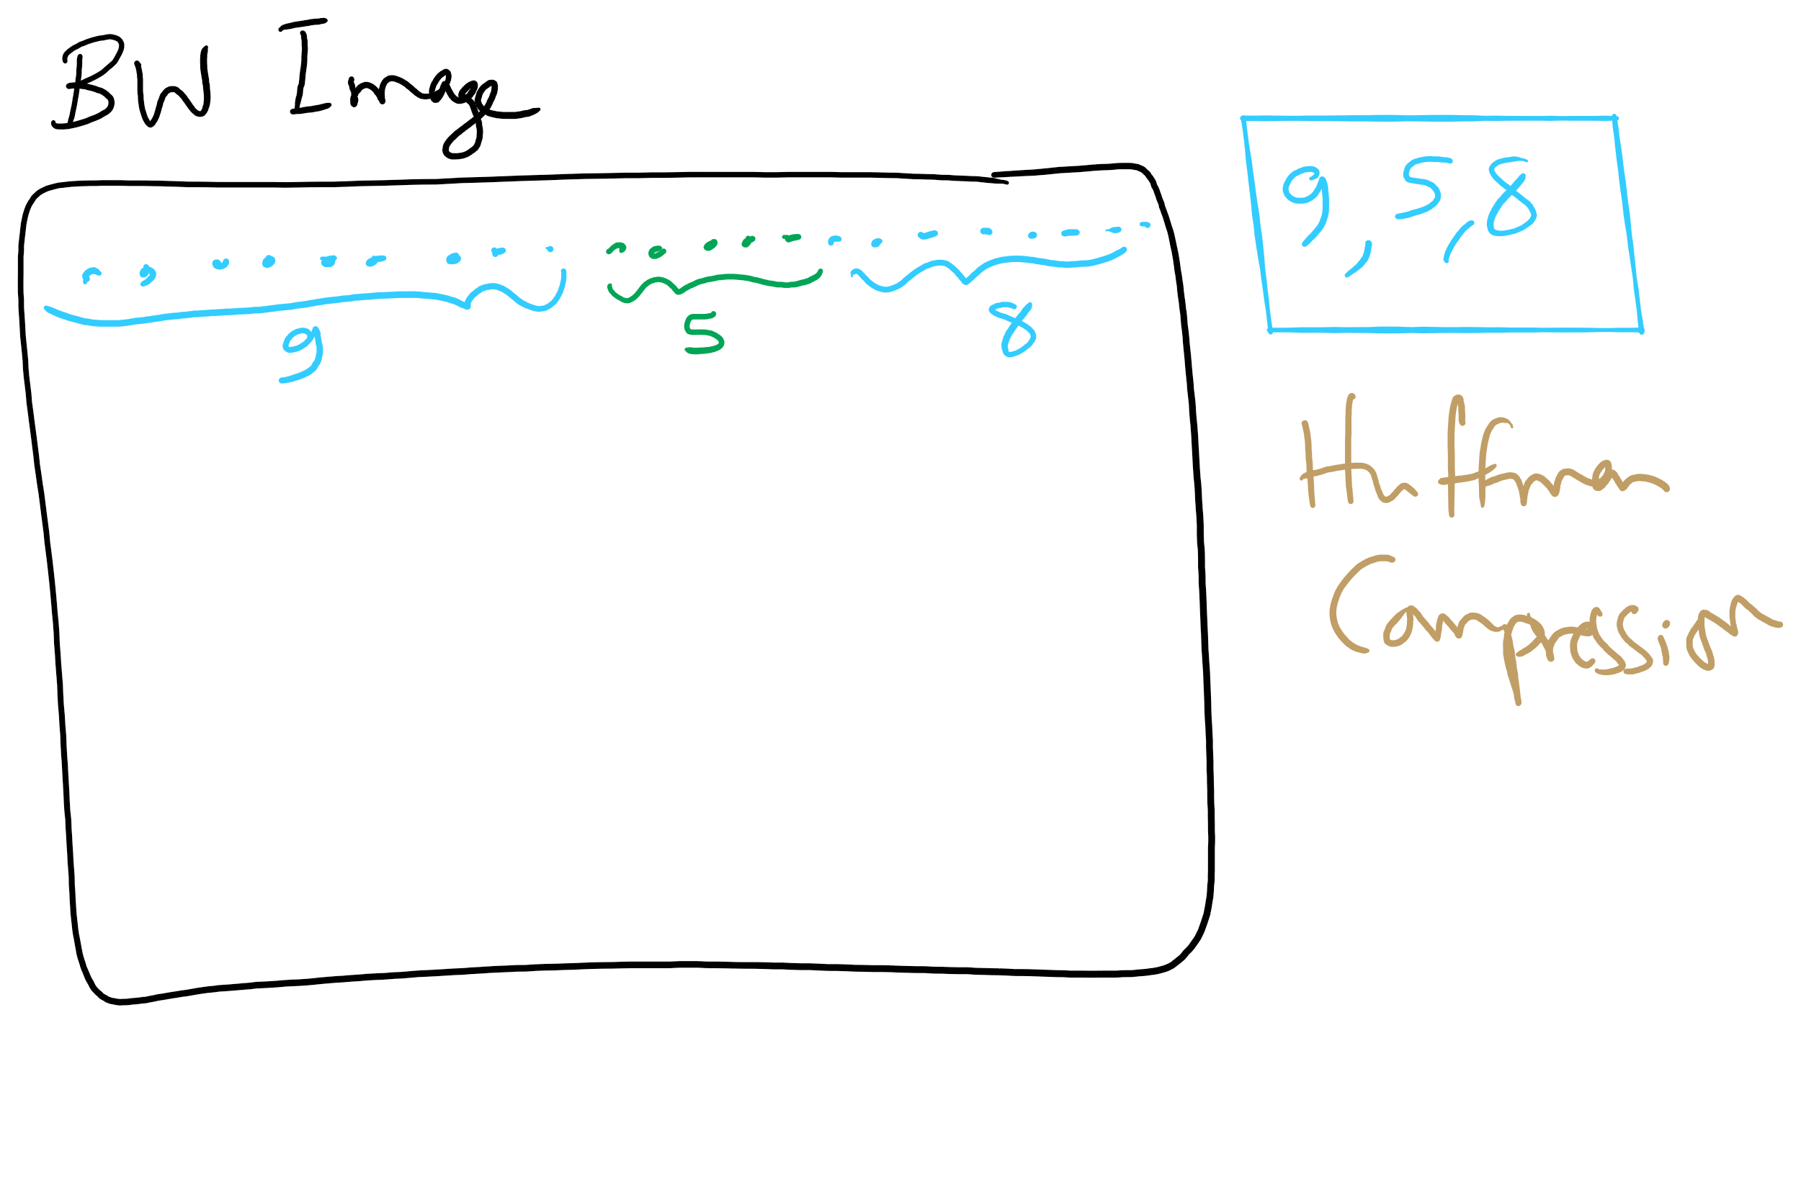
Run-length Encoding

Slide 22
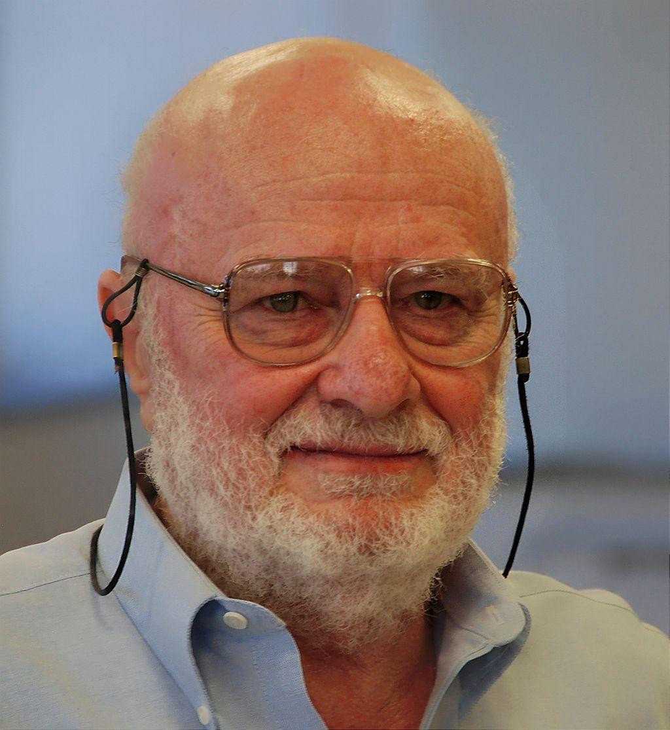
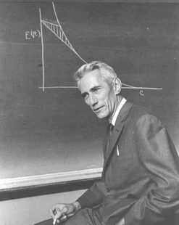
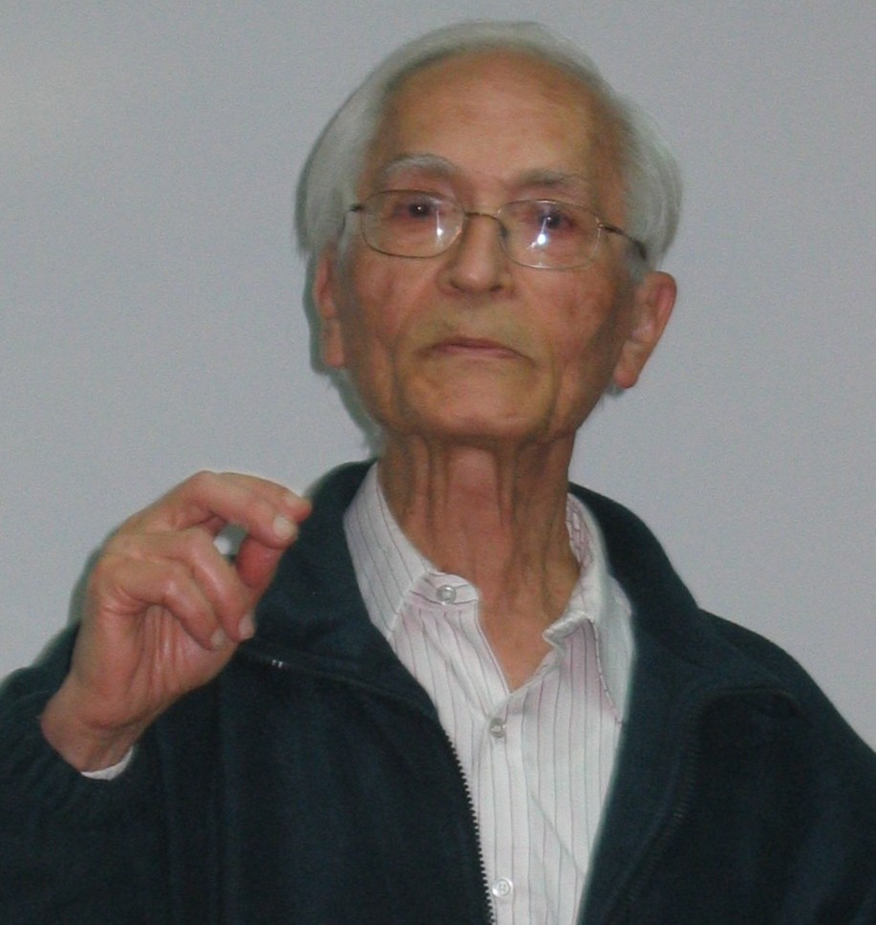
What else can we do to compress files?
Notes:
left to right:
Abraham Lempel, Jacob Ziv, and Claude Shannon

Slide 23
Patterns are compressible, need a general approach
Huffman used variable-length codewords to represent fixed-length portions of the input…
Let’s try another approach that uses fixed-length codewords to represent variable-length portions of the input
Idea: the more characters can be represented in a single codeword, the better the compression
Consider “the”: 24 bits in ASCII
Representing “the” with a single 12 bit codeword cuts the used space in half
Similarly, representing longer strings with a 12 bit codeword would mean even better savings!

Slide 24
How do we know that “the” will be in our file?
Need to avoid the same problems as the use of a static trie for Huffman encoding…
So use an adaptive algorithm and build up our patterns and codewords as we go through the file

Slide 25
LZW compression
Initialize codebook to all single characters
e.g., character maps to its ASCII value
While !EOF:
Match longest prefix in codebook
Output codeword
Take this longest prefix, add the next character in the file, and add the result to the dictionary with a new codeword

Slide 26
LZW compression example
Compress, using 12 bit codewords:
TOBEORNOTTOBEORTOBEORNOT
Cur
Output
Add
T
84
TT:264
T
84
TO:256
TO
256
TOB:265
O
79
OB:257
BE
258
BEO:266
B
66
BE:258
OR
260
ORT:267
E
69
EO:259
TOB
265
TOBE:268
O
79
OR:260
EO
259
EOR:269
R
82
RN:261
RN
261
RNO:270
N
78
NO:262
OT
263
--
O
79
OT:263

Slide 27
LZW expansion
Initialize codebook to all single characters
e.g., ASCII value maps to its character
While !EOF:
Read next codeword from file
Lookup corresponding pattern in the codebook
Output that pattern
Add the previous pattern + the first character of the current pattern to the codebook
Note this means no codebook addition after first pattern output!

Slide 28
LZW expansion example
Cur
Output
Add
84
T
263:OT
84
T
--
256
TO
264:TT
79
O
256:TO
258
BE
265:TOB
66
B
257:OB
260
OR
266:BEO
69
E
258:BE
265
TOB
267:ORT
79
O
259:EO
259
EO
268:TOBE
82
R
260:OR
261
RN
269:EOR
78
N
261:RN
263
OT
270:RNO
79
O
262:NO

Slide 29
How does this work out?
Both compression and expansion construct the same codebook!
Compression stores character string → codeword
Expansion stores codeword → character string
They contain the same pairs in the same order
Hence, the codebook doesn’t need to be stored with the compressed file, saving space

Slide 30
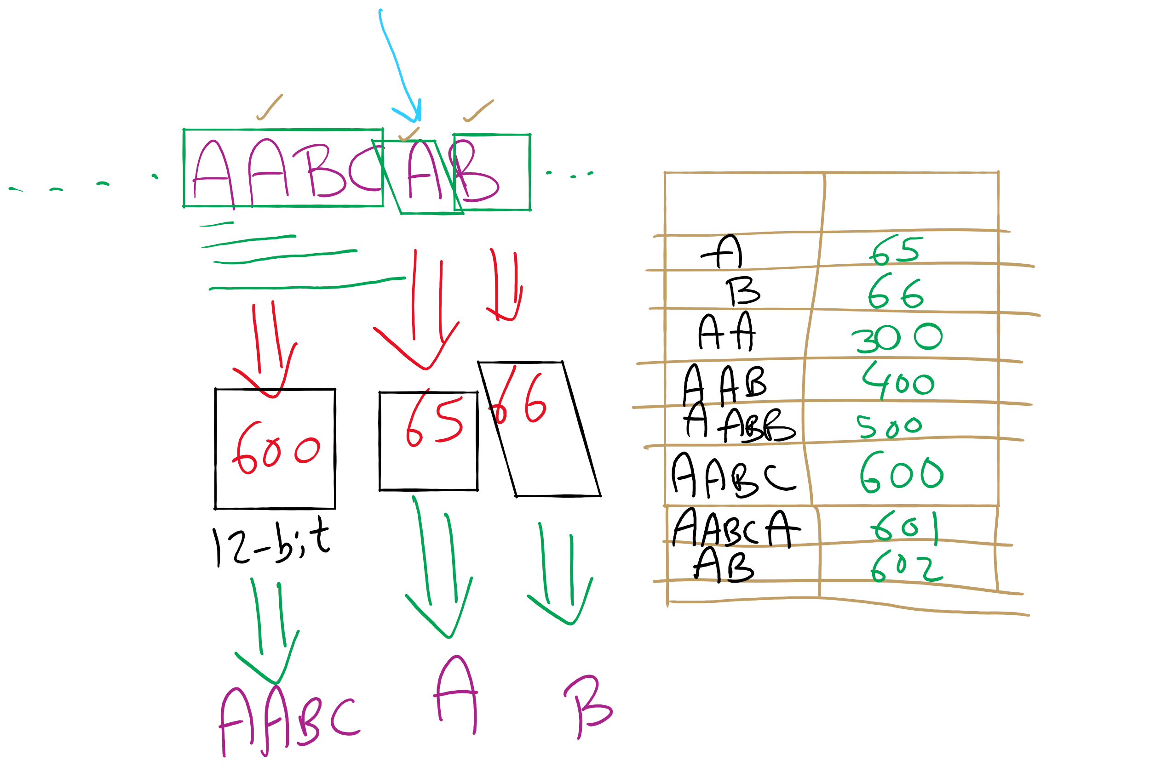
LZW Example

Slide 31
Just one tiny little issue to sort out...
Expansion can sometimes be a step ahead of compression…
If, during compression, the (pattern, codeword) that was just added to the dictionary is immediately used in the next step, the decompression algorithm will not yet know the codeword.
This is easily detected and dealt with, however

Slide 32
LZW corner case example
Compress, using 12 bit codewords: AAAAAA
Cur
Output
Add
A
65
AA:256
AA
256
AAA:257
AAA
257
--
Expansion:
Cur
Output
Add
65
A
--
256
AA
256:AA
257
AAA
257:AAA
Notes:
If a codeword is encountered that is not in the codebook, it must be:
prev_pattern + prev_pattern[0]

Slide 33
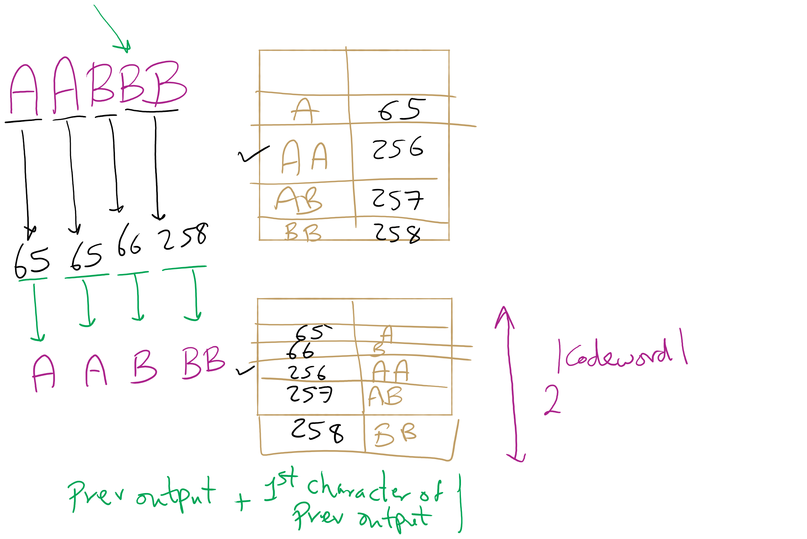
LZW Corner Case

Slide 34
LZW implementation concerns: codebook
How to represent/store during:
Compression
Expansion
Considerations:
What operations are needed?
How many of these operations are going to be performed?
Discuss
Notes:
ENCODE: Two most likely candidates:
Trie or Hash Table
Both allow lookups in time proportional to string length, independent of the number of strings
Since the new keys are all prefixes already in the tree, and plus one additional character, and since we are searching for prefixes
The Trie would be a great choice
However, memory issues would make us prefer the DLB
Text LZW.java uses a ternary search trie (TST).
DECODE:
Now codewords are the key values, and the strings are returned
We can simply use the codeword values to index an array of strings
Gives us constant time lookup of the codewords
See LZW.java

Slide 35
Further implementation issues: codeword size
How long should codewords be?
Use fewer bits:
Gives better compression earlier on
But, leaves fewer codewords available, which will hamper compression later on
Use more bits:
Delays actual compression until longer patterns are found due to large codeword size
More codewords available means that greater compression gains can be made later on in the process

Slide 36
Variable width codewords
This sounds eerily like variable length codewords…
Exactly what we set out to avoid!
Here, we’re talking about a different technique
Example:
Start out using 9 bit codewords
When codeword 512 is inserted into the codebook, switch to outputting/grabbing 10 bit codewords
When codeword 1024 is inserted into the codebook, switch to outputting/grabbing 11 bit codewords…
Etc.

Slide 37
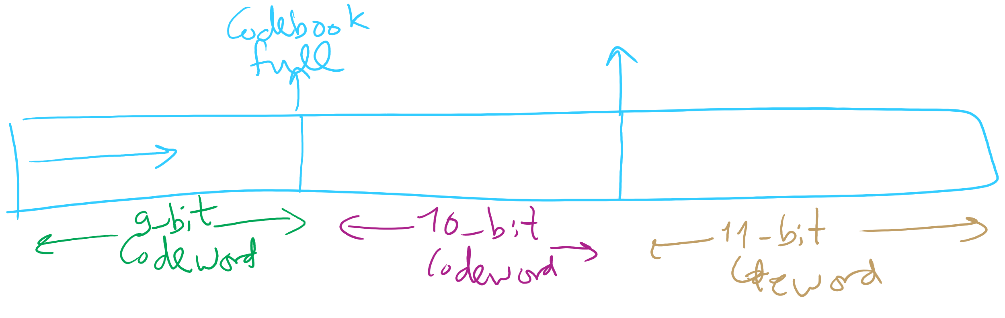
Adaptive Codeword Size

Slide 38
Even further implementation issues: codebook size
What happens when we run out of codewords?
Only 2^{n} possible codewords for n bit codes
Even using variable width codewords, they can’t grow arbitrarily large…
Two primary options:
Stop adding new keywords, use the codebook as it stands
Maintains long already established patterns
But if the file changes, it will not be compressed as effectively
Throw out the codebook and start over from single characters
Allows new patterns to be compressed
Until new patterns are built up, though, compression will be minimal

Slide 39
The showdown you’ve all been waiting for...
HUFFMAN vs LZW
In general, LZW will give better compression
Also better for compression archived directories of files
Why?
Very long patterns can be built up, leading to better compression
Different files don’t “hurt” each other as they did in Huffman
Remember our thoughts on using static tries?

Slide 40
So lossless compression apps use LZW?
Well, gifs can use it
And pdfs
Most dedicated compression applications use other algorithms:
DEFLATE (combination of LZ77 and Huffman)
Used by PKZIP and gzip
Burrows-Wheeler transforms
Used by bzip2
LZMA
Used by 7-zip
brotli
Introduced by Google in Sept. 2015
Based around a " … combination of a modern variant of the LZ77 algorithm, Huffman coding[,] and 2nd order context modeling … "
Notes:
also: lz4, lzham, bitknit as a close competitor to brotli

Slide 41
DEFLATE et al achieve even better general compression?
How much can they compress a file?
Better question:
How much can a file be compressed by any algorithm?
No algorithm can compress every bitstream
Assume we have such an algorithm
We can use to compress its own output!
And we could keep compressing its output until our compressed file is 0 bits!
Clearly this can’t work
Proofs in Proposition S of Section 5.5 of the text

Slide 42
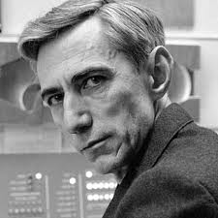
Can we reason about how much a file can be compressed?
Yes! Using Shannon Entropy
Notes:
brief bio:
1937 MIT masters thesis showed electromechanical telephone switching relays could be used to solve boolean algebra
foundation of digital circuit design
1940 PhD from MIT, became a researcher at Institute for Advanced Study in Princeton
WWII moved to Bell Labs to work on fire-control systems and crypto
Proved security of one-time pad ciphers here
1948 A Mathematical Theory of Communication
Developed High-Low blackjack card counting method with Ed Thorp
Credited with creating the first wearable computer to help calculate roulette odds
Shannon's Maxim is counterpoint of security through obscurity

Slide 43
Information theory in a single slide...
Founded by Claude Shannon in his paper “A Mathematical Theory of Communication”
Entropy is a key measure in information theory
Slightly different from thermodynamic entropy
A measure of the unpredictability of information content
By losslessly compressing data, we represent the same information in less space
Hence, 8 bits of uncompressed text has less entropy than 8 bits of compressed data
Notes:
1948

Slide 44
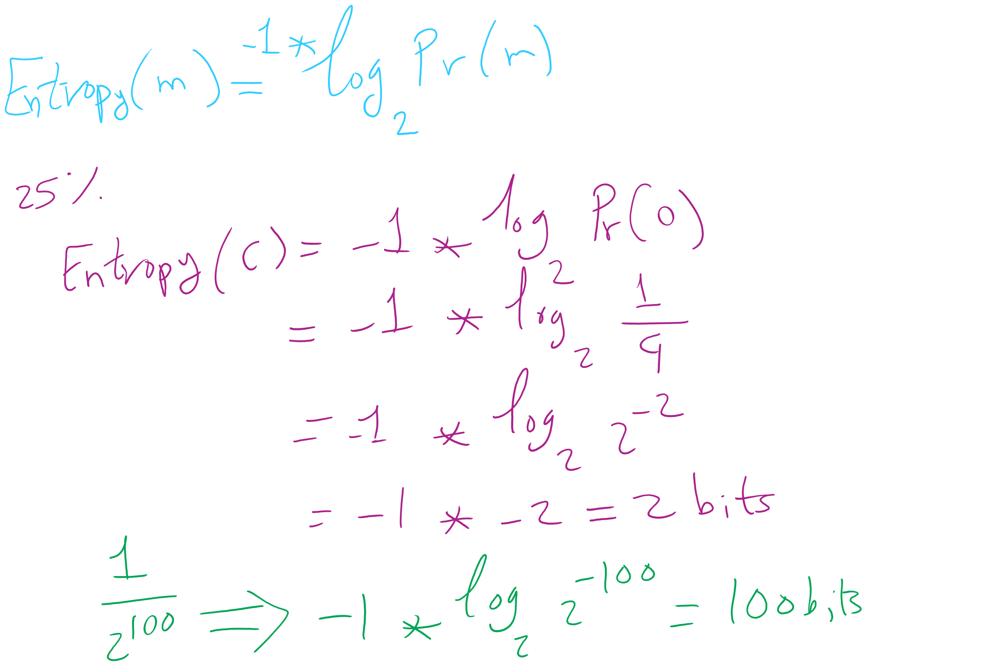
Entropy Equation

Slide 45
Entropy applied to language:
Translating a language into binary, the entropy is the average number of bits required to store a letter of the language
Entropy of a message * length of message = amount of information contained in that message
On average, a lossless compression scheme cannot compress a message to have more than 1 bit of information per bit of compressed message
Uncompressed, English has between 0.6 and 1.3 bits of entropy per character of the message

Slide 46
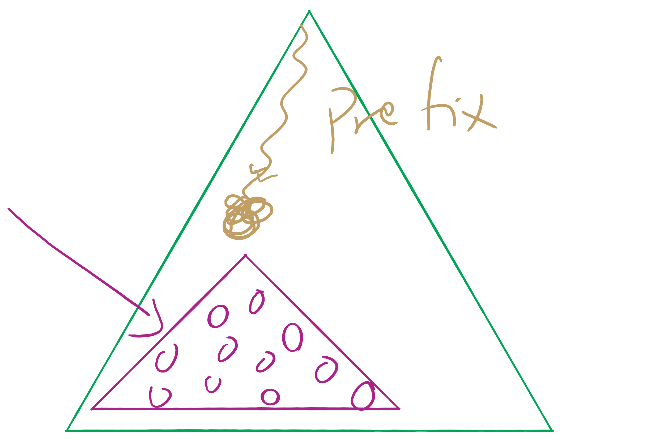
Assignment 2 runtime analysis

Slide 47
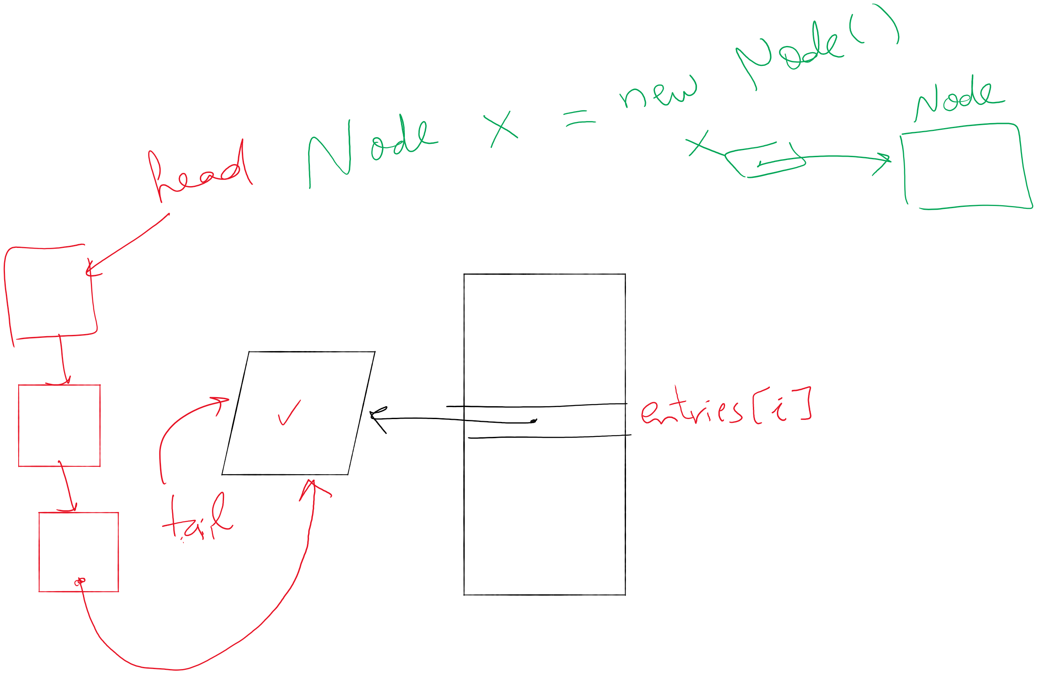
Lab 6

Slide 48
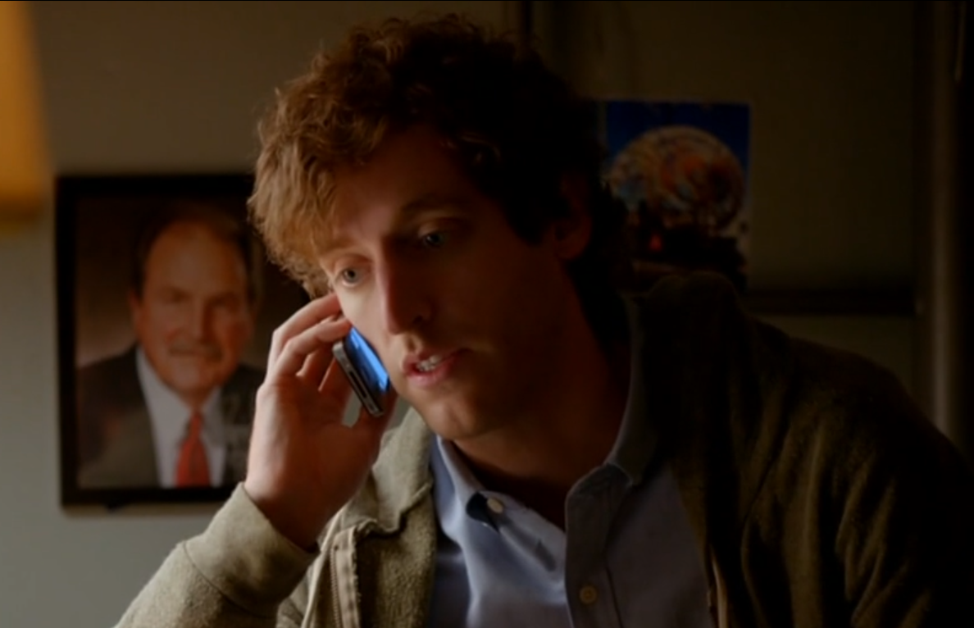
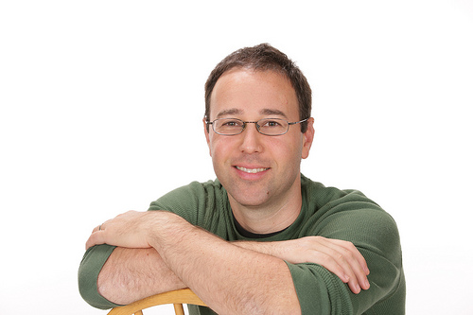
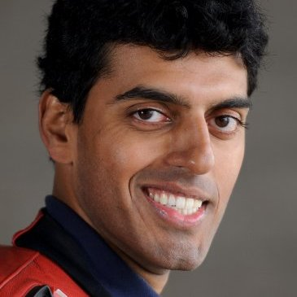
A final note on compression evaluation
"Weissman scores" are a made-up metric for Silicon Valley (TV)
Notes:
first: Prof. Tsachy (Itschak) Weissman (Stanford Dept. of EE)
second: Vinith Misra, advised by Weissman while getting his PhD from Stanford, now at IBM
Misra was a technical advisor to silicon valley team, made the shows technical contributions seem like something experts could watch a powerpoint on and buy

Slide 49
Please submit your reflections by using the CourseMIRROR App
If you are having a problem with CourseMIRROR, please send an email to coursemirror.development@gmail.com
Notes:
All right!
Upcoming Due Dates at A Glance

